Slide 1
Fruit Tree Maintenance
Notes:
Thank you to Giving Grove- they have lots of resources, explain briefly what Giving Grove is

Slide 2
This is a series!
If you’re curious on what to plant, what varieties to choose, how to plant the tree or how to see if you have a good site – check out the previous class, it’s available on the resource tab of our website (theunitygardens.org)
Next class will cover how to figure out what’s going wrong with your tree- including common pests/diseases

Slide 3
General Maintenance

Slide 4
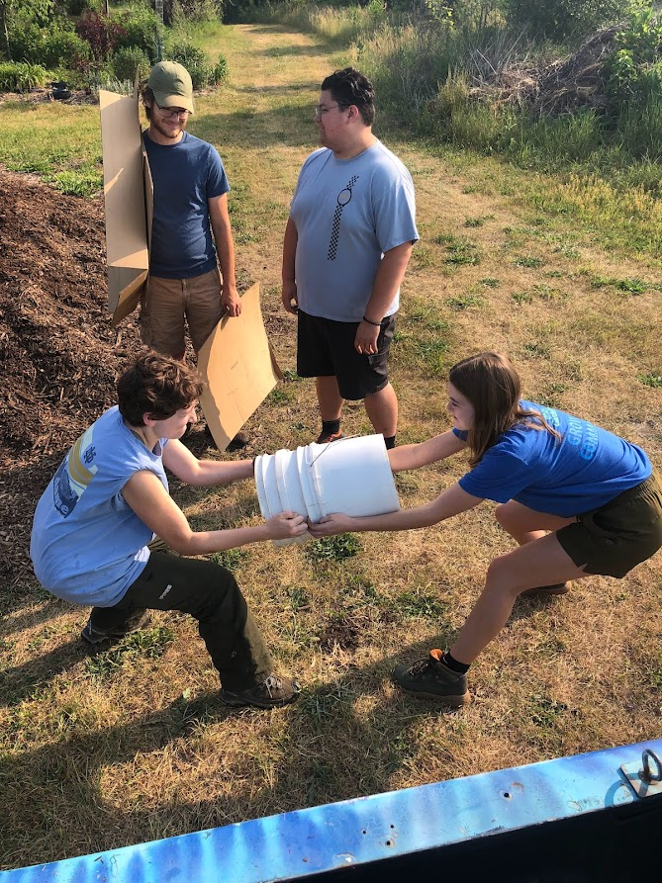
Water
Water is what keeps your trees alive!
Make sure to water especially in drought times
This is especially important for unestablished trees (the first 1-3 years after planting)
Water 5 gallons a week if you haven’t received an inch of rainfall
If you’re not sure, water anyway!
Notes:
5 gallon buckets are super useful- if you want to water with a hose, count how long it takes to fill a 5 gallon bucket and that’s how long you should water your tree with the hose

Slide 5
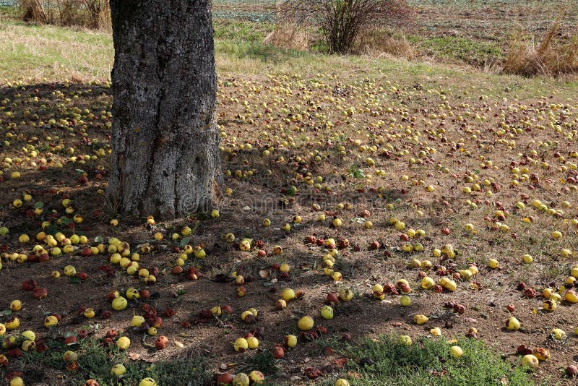
Sanitation
Keep your orchards clean!
Pick up brush and fallen fruit, especially in fall
Keep your tools clean
Clean between cuts
Remove pruned branches, ESPECIALLY if they’re diseased or unhealthy
This keeps disease out of your orchard!
Notes:
Don’t burn canker! And pack things OUT of the orchard

Slide 6
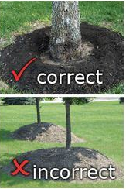
Mulching
Why Mulch?
Keeps weeds down and prevents them from competing with your trees, especially baby trees
Retains water better, hinders evaporation
Keep area around trees weeded
When mulching, think donut NOT volcano
Volcano mulching smothers the tree bark, keeps it wet and introduces disease easily
Notes:
Can get mulch for free from south bend organic resources

Slide 7
Pruning Overview

Slide 8
Purpose of pruning
Maintain good airflow and sunlight through the tree
Give a good structure to support weight of fruit
Good rule of thumb: a good fruit tree does not equal a good shade tree
Good airflow – prevents disease
Good sunlight – improves ripening
Do not need to paint over/seal wounds – this is an old wives’ tale and actually slows down the trees healing process!
Notes:
Tree also has limited energy, very similar reasons to why you prune a tomato

Slide 9
Good tree pruning should look like:

Slide 10
When to Prune
Typically – late in dormant season, when the trees are still dormant but not in cold cold temperatures or you’ll damage your tree (February – March)
Avoid pruning when it’s raining/snowing
Avoid pruning in temperatures below freezing
Prune pomme fruits first, stonefruits second
June – prune for size, watersprouts and ground suckers
Do not prune in fall/early winter, the tree will not heal before winter comes!

Slide 11
Best Pruning Practices

Slide 12
Leave a branch collar! This helps the tree heal from cuts

Slide 13
Tools
Use pruning shears that will give you clean cuts, keep your tools sharp
Messy cuts will lead to disease!
Sanitize between cuts (I use 10% bleach spray)
If you’re impatient at least sanitize between trees and between cuts on an unhealthy tree
Generally don’t need electric, that’ll jar the tree
Notes:
Also an orchard ladder

Slide 14
Terminology

Slide 15
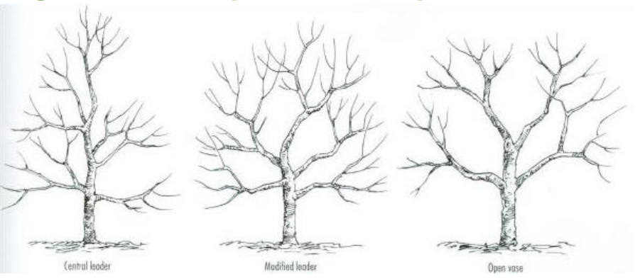
Types of pruning:
Open vase pruning – best for stonefruits (peaches, cherries)
Central leader pruning – best for pomme fruits (apples, pears)

Slide 16
Central Leader Pruning

Slide 17
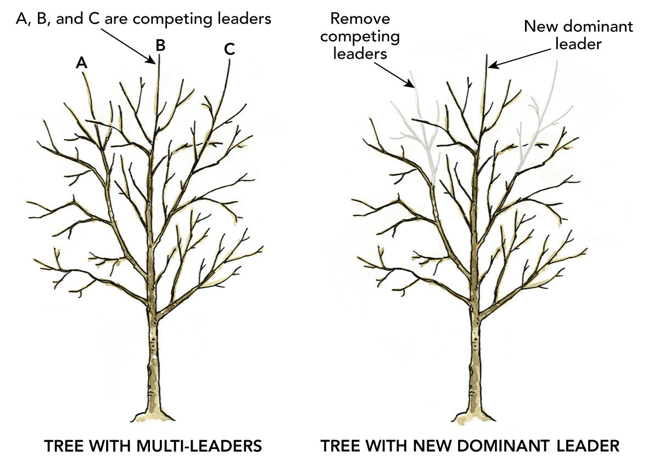
Competing leaders
For central leader pruning, you need to pick one central leader
Choose the straightest or strongest leader and remove the other, either with thinning or heading cuts

Slide 18
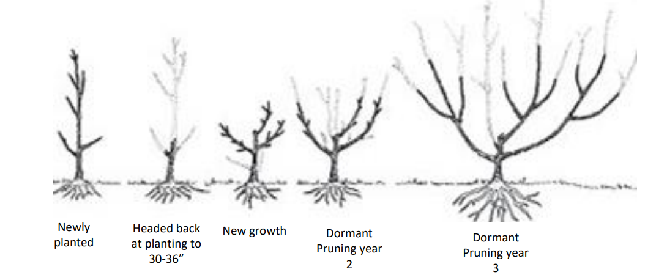
Open Center Pruning

Slide 19
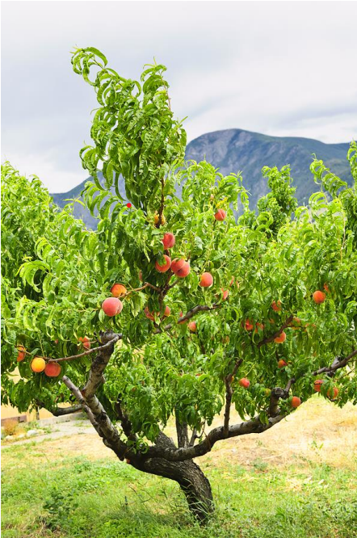
A Note on Peaches
Peaches only fruit on second year wood, so prune more aggressively on peaches than other fruit trees
They’re an open center fruit tree, so keep that center clear!

Slide 20
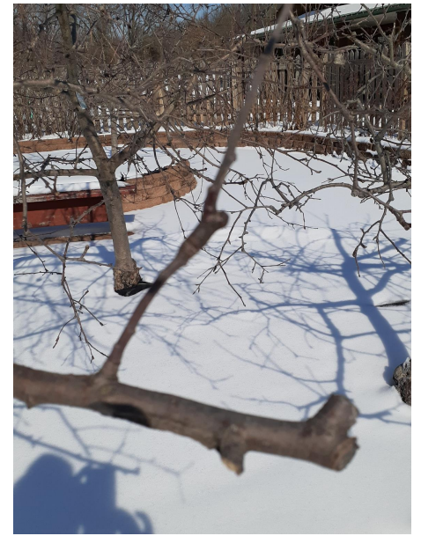
Types of Cuts
Thinning – taking out a whole branch (cutting where the branch attaches to the trunk, usually what’s recommended to clean out trees)
Heading – taking out a section of the branch, usually cutting back to a outgoing branch or a bud (can help redirect where your branches are growing and keep it from intersecting with another branch, will usually cause watersprouts so be careful with heading cuts)
Don’t leave stubs like this →

Slide 21
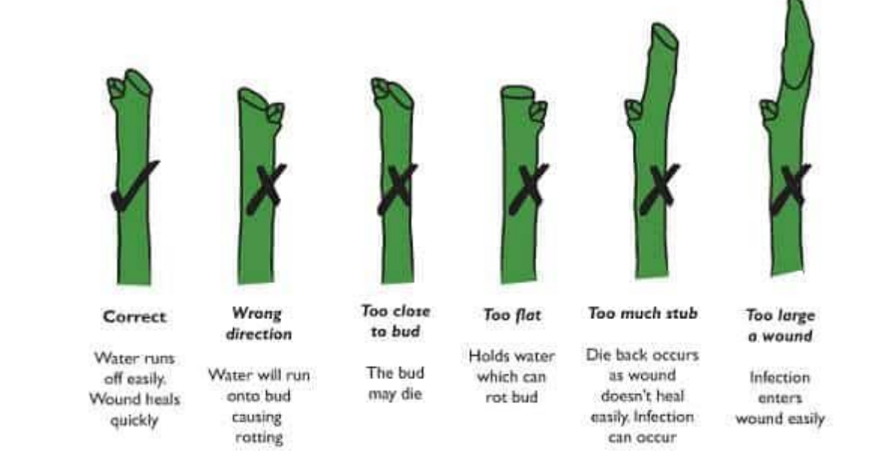
A Good Heading Cut!

Slide 22
What to Prune
Disclaimer: pruning is an art, not a science! There isn’t one correct way to prune a tree and not one right answer on how to prune it, every tree will grow a little differently. And pruning is a tough skill to learn, so be kind to yourself in this process!

Slide 23
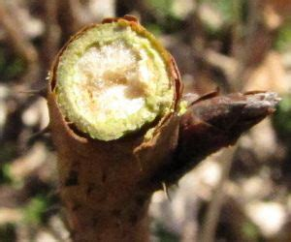
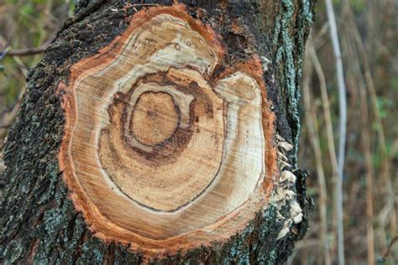
Dead Stuff
Prune off anything dead
Dead stuff will have a brown cross-section and snap easily
Use heading cuts here to cut back to the live sections of the tree
Use the heading cuts in a way that will encourage the tree to grow in a direction you like

Slide 24
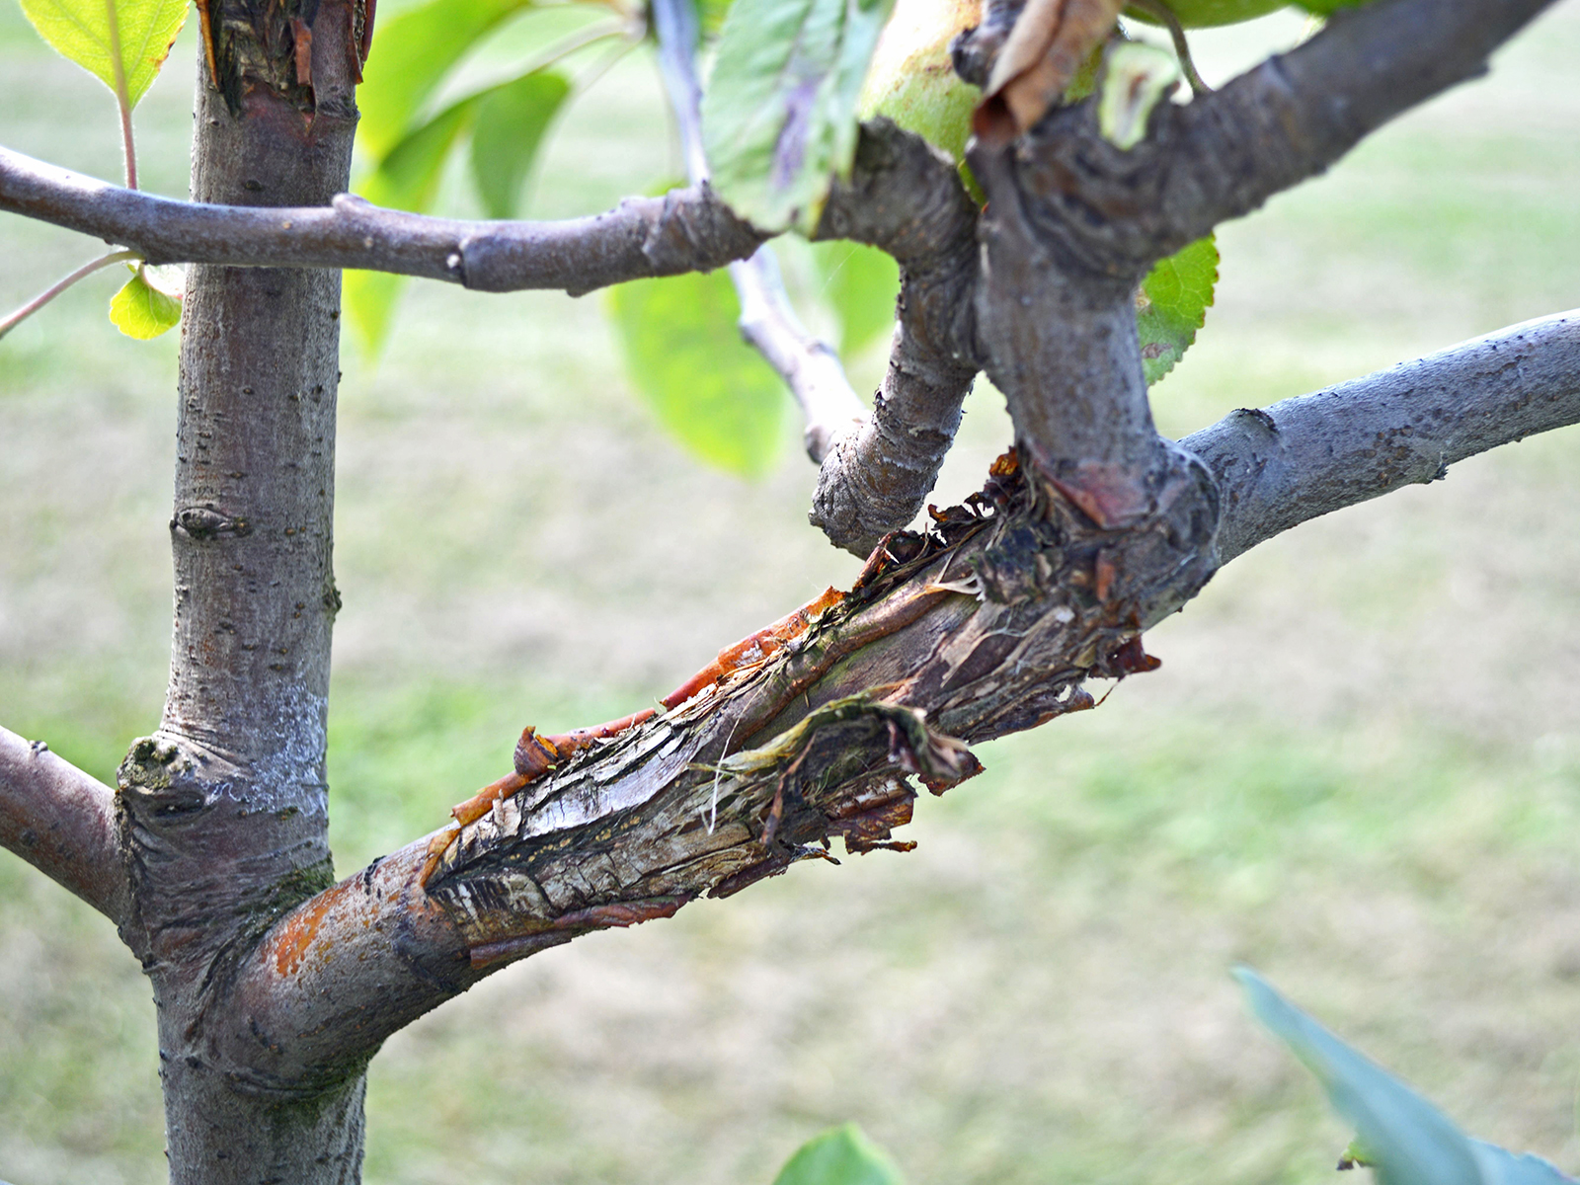
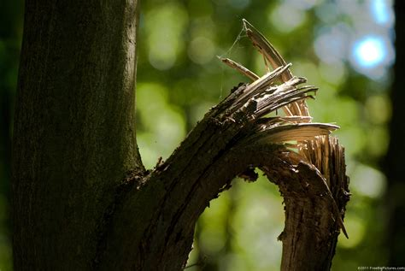
Diseased/damaged stuff
Any cracked branches, any branches that may be infected
Prune it off so it won’t affect the rest of the tree

Slide 25
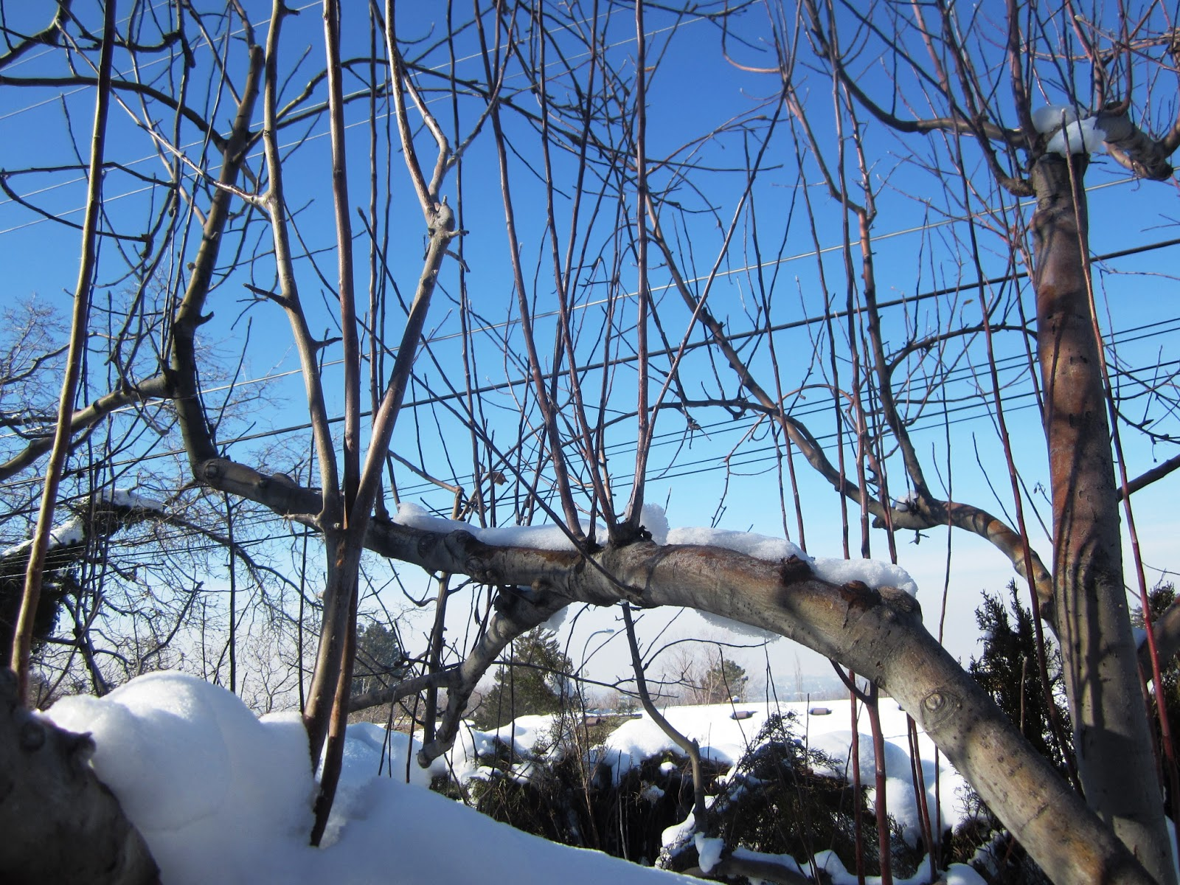
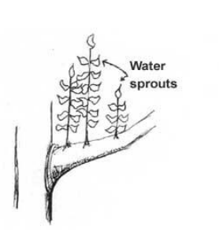
Watersprouts
Watersprouts are vigorous growth that are mostly vegetative (won’t bear fruit)
They usually come from last year’s pruning cuts
Will grow straight up towards sunlight and mess up the airflow and structure of your tree
Usually more prone to breaking/disease because it grows so quickly
Will drain the tree of nutrients needed to bear a good fruit crop

Slide 26
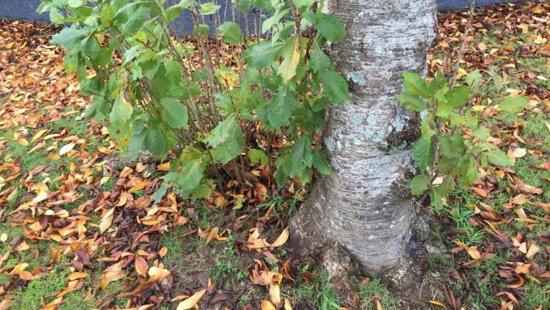
Ground suckers
It’ll be an extra tree! Take it out! Sometimes it’s not even the fruiting part, it’s the rootstock!

Slide 27
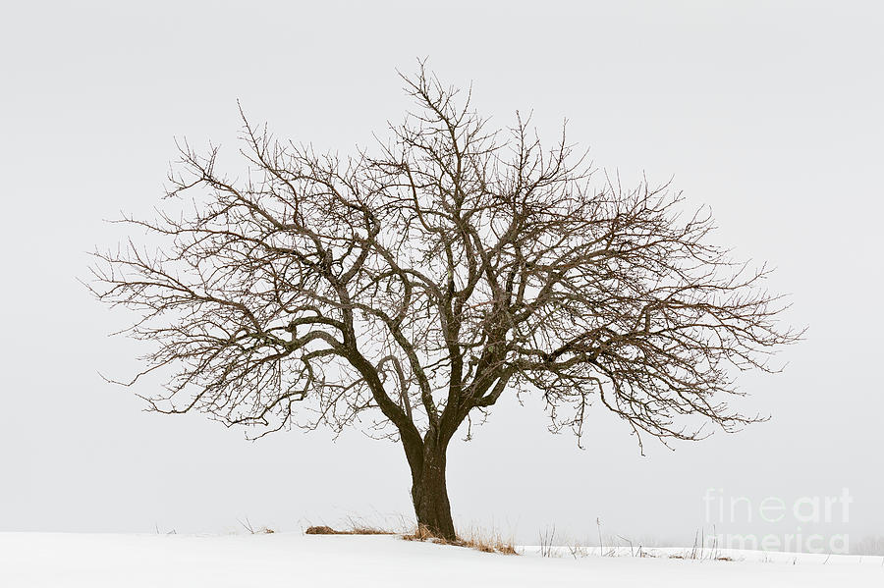
Downward growing branches
Will usually be shaded out by other branches and therefore won’t bear fruit
Also more likely to break in storms
Exception: I might leave some for big trees in free pick orchards for kids to reach!

Slide 28
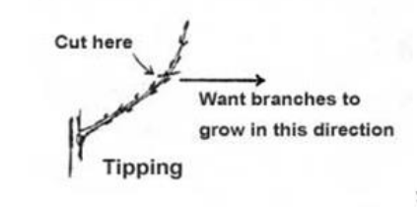
Branches up or towards the center
Branches growing straight up are most likely watersprouts, or branches that you can prune to grow out instead
They won’t produce much fruit growing straight up
Branches growing towards the center will interrupt airflow and sunlight penetration

Slide 29
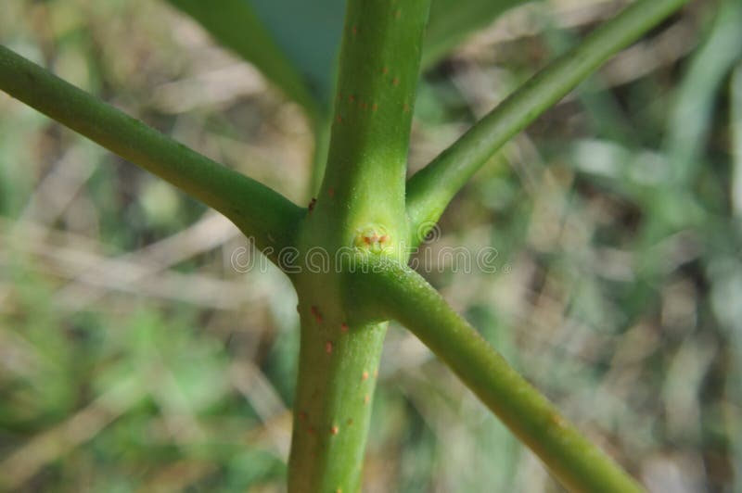
Whorls
Whorls are when branches originate from the same place on the tree trunk
This weakens the whole tree structure, making it prone to breaking
Choose the stronger or better positioned of the whorl to keep, prune off the others

Slide 30
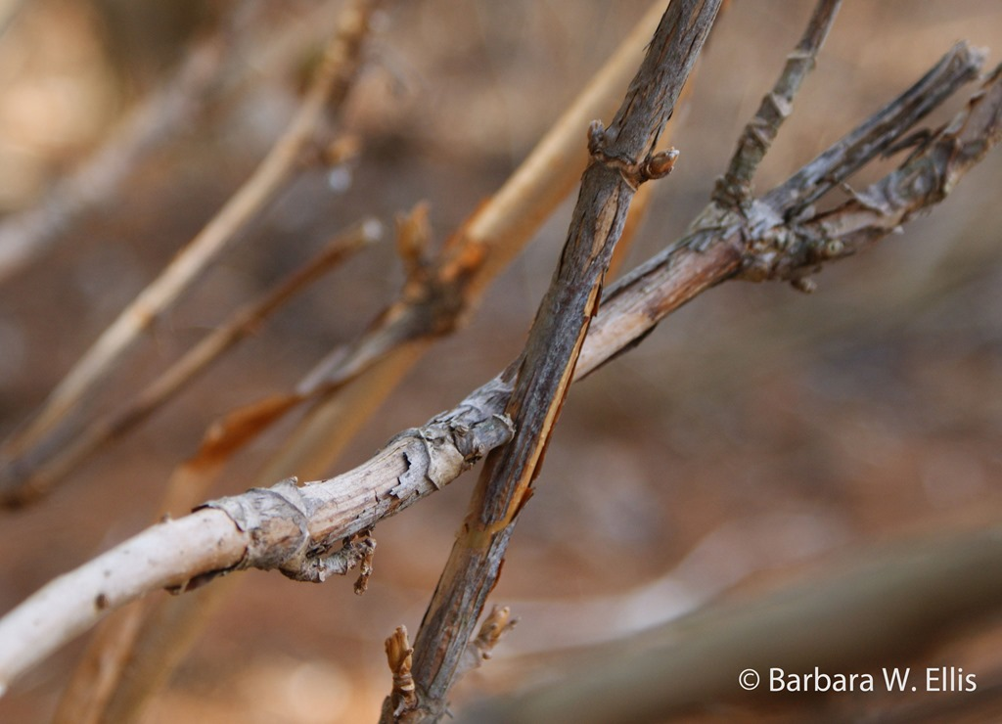
Rubbing branches
Pulls away bark and introduces disease into the tree
One is also likely going an unfortunate direction
Can use a thinning cut to remove the whole branch or a heading cut to redirect one of the branches

Slide 31
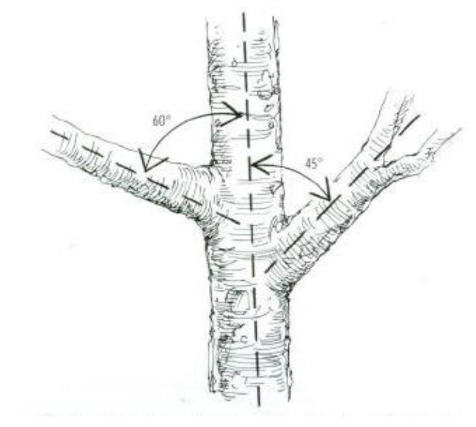
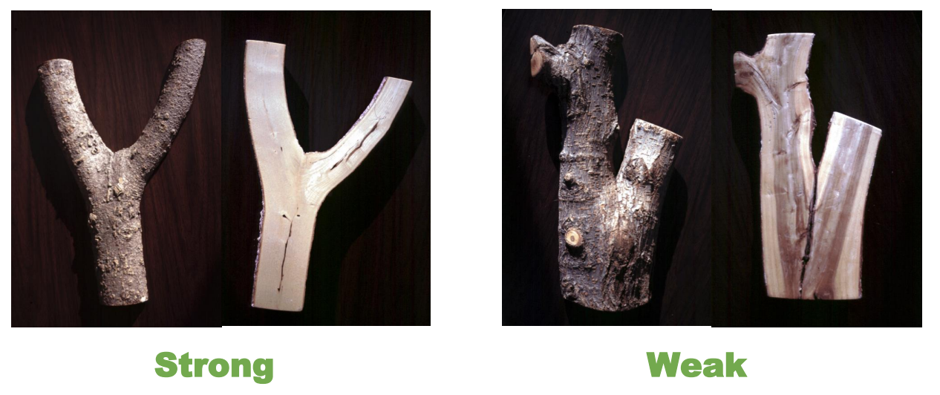
Narrow angled branches
Good angles are important for the tree to support itself with heavy fruit or in storms
Narrow angles or too wide angles are unstable and will break easily
Choose to keep branches with good angles over bad ones
Or to use limb spreaders when the branches are pliable to create good angles from narrow ones

Slide 32
Mature Fruit Tree Pruning
Can not cut back a mature fruit tree that’s never been pruned to a good fruit tree in one season
Do not cut more than 30% of trees per year
Take out the worst offenders first and go back from there

Slide 33
Takeaways!
The 4 Ds of pruning:
• Dead • Diseased • Damaged • Deranged

Slide 34
thinning

Slide 35
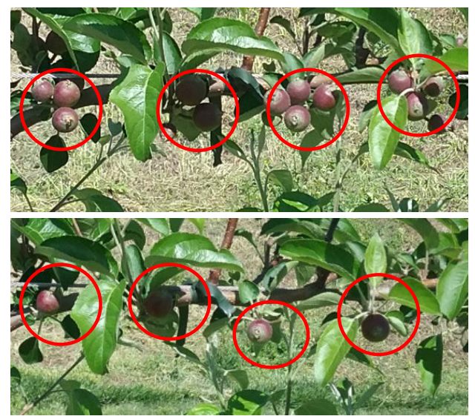
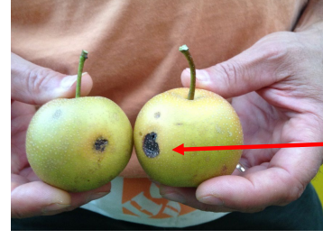
Purpose of Thinning
On apples, pears and peaches
To let some fruits mature completely and unblemished
To not exhaust your tree
Timing: June
Wait until after June drop!

Slide 36
spraying

Slide 37
Holistic Spray
Commercial orchards spray extremely often
Because they have varieties you’re familiar with that are susceptible to pests and diseases
If you have good tree varieties and take care of them well, hopefully you won’t have disease/pest pressure
A healthy and well-pruned tree is less susceptible to pests
We follow the spray regimen recommended by the Giving Grove

Slide 38
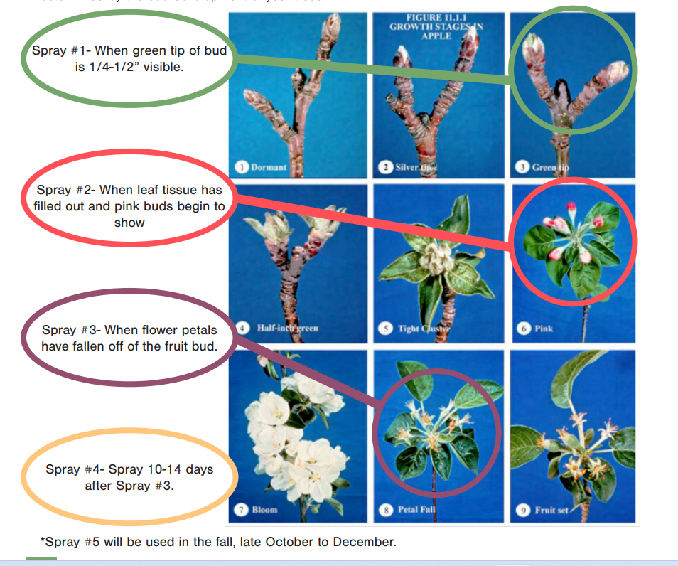
Spray #1-4 are April/May
Spray #5 is about November

Slide 39
Recipe for Holistic Spray for 1st spray and fall spray (1% neem)
Per 1 Gallon of Water:
2.25 Tbsp Neem
1 tsp liquid dish soap (Dr. Bonner’s or Dawn recommended)
3 Tbsp (1.5oz) BioAg probiotic
5 Tbsp (2.5 oz) liquid fish (in fall, double fish amount)
If neem has been in a cool area, warm up overnight
Combine neem and soap and stir vigorously
Add liquid fish and BioAg
Add warm water last and shake vigorously
Spray whole tree! In fall, also spray leaf/tree matter on the ground

Slide 40
Recipe for 2nd, 3rd, and 4th sprays (.5% neem)
For 1 gallon of water
1.25 Tbsp (.6 oz) of Neem
½ tsp liquid dish soap (Dr. Bonner or Dawn recommended)
3 Tbsp (1.25 oz) BioAg probiotic
5 Tbsp (2.5 oz) liquid fish
If neem has been in a cool area, warm up overnight
Combine neem and soap and stir vigorously
Add liquid fish and BioAg
Add warm water last and shake vigorously

Slide 41
Any questions?
Next fruit tree class is on October 12th – what’s wrong with my fruit tree and how do I fix it?

